Slide 1

The influence of irrigation flows on microbial and algal nutrient limitation
Sarah S. Roley
Clay Arango
Alex Alexiades

Slide 2
Irrigated Agriculture
USGS 2004

Slide 3
Irrigation season
River → Field → River
Non-Irrigation season
Groundwater → River
USGS 2004
What limits microbial and algal production during irrigation vs. non-irrigation season?

Slide 4
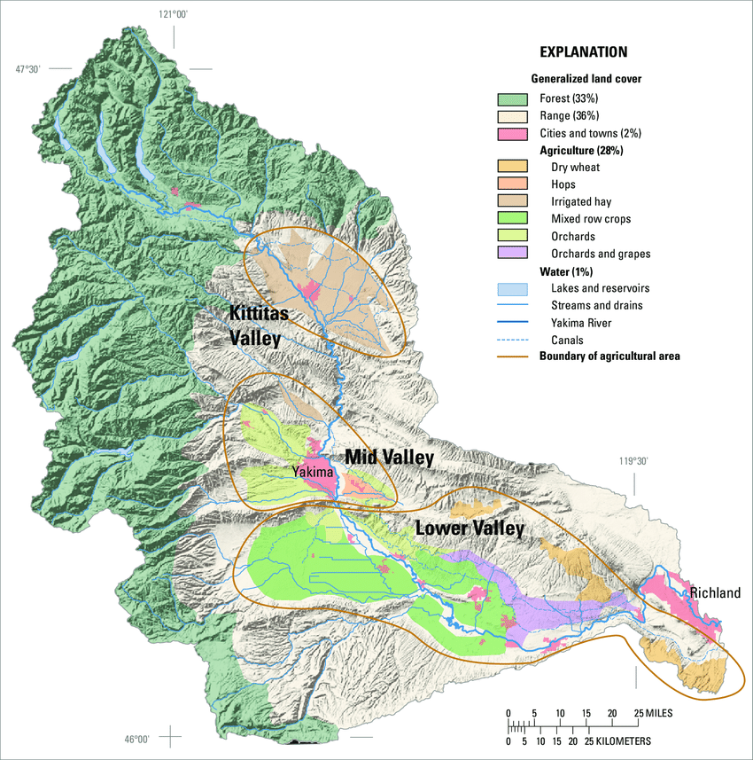
Yakima River Basin
irrigated hay
[map of Washington]
orchards
mixed row crops
orchards & grapes
dry wheat

Slide 5
Hypotheses
Nutrient limitation will be more pronounced in the upper Basin
Nutrient limitation will occur during non-irrigation season

Slide 6
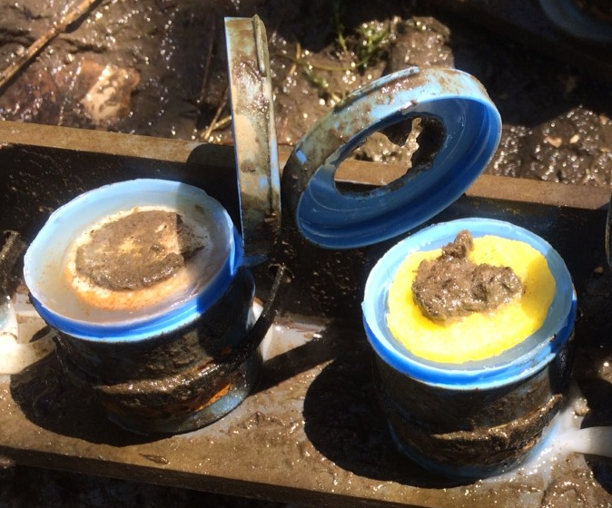
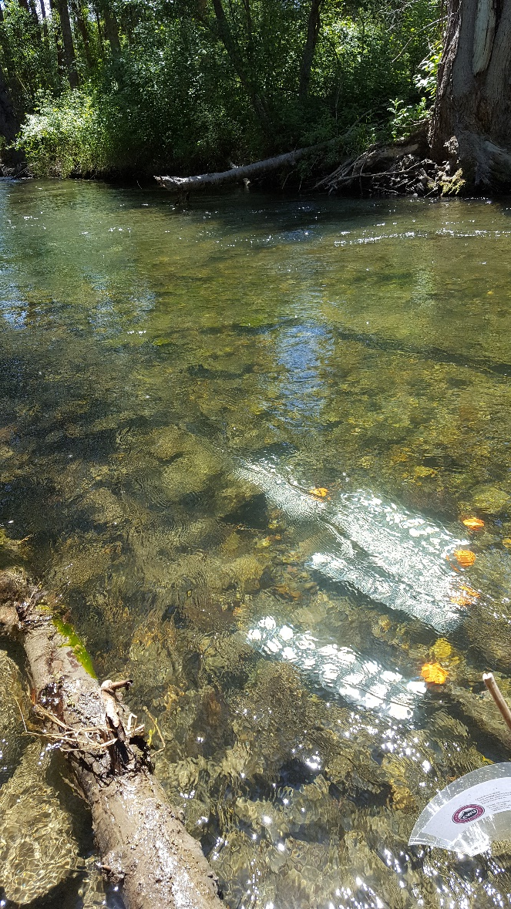
Methods – Nutrient-Diffusing Substrates (NDS)
Glass – for primary producers
Cellulose – for heterotrophs
Agar + nutrients (N, P, Si, or combination)

Slide 7
Study sites – tributaries of the Yakima River
irrigated hay
[map of Washington]
orchards
mixed row crops
orchards & grapes
dry wheat

Slide 8
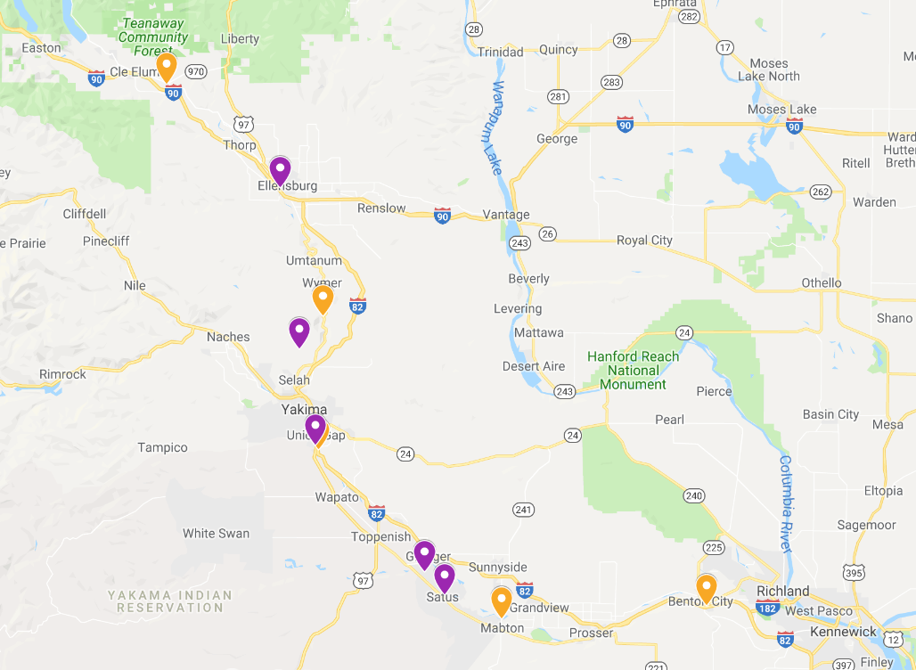
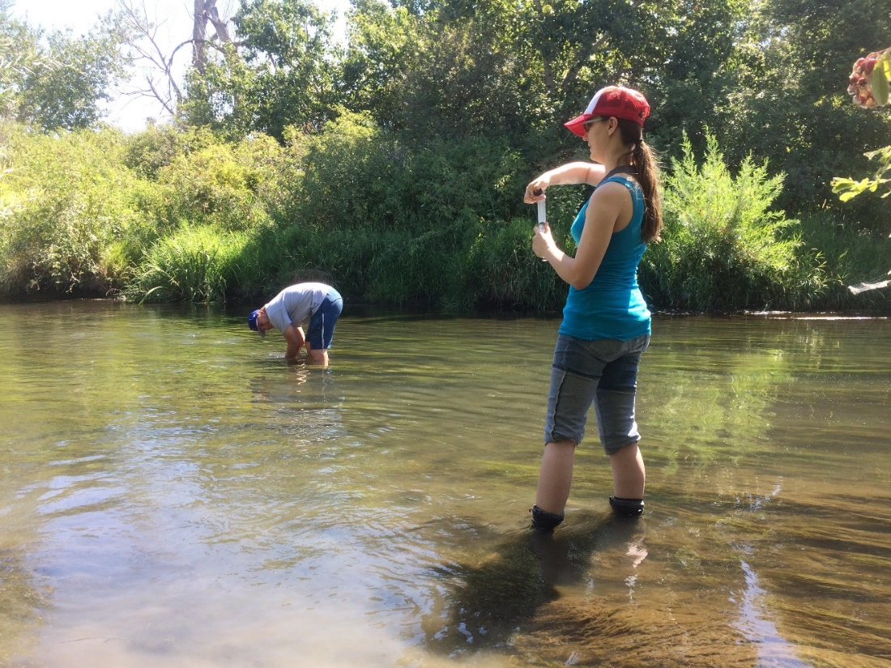
Sites – Yakima River Basin
Yakima Mainstem
Tributaries

Slide 9
[Nitrogen] ↑ downstream, with irrigation
upstream → downstream

Slide 10
[Nitrogen] ↑ downstream, with irrigation

Slide 11
[DOC] varies with season, location
Leaf litter input?
Autochthonous inputs?
upstream → downstream

Slide 12
GPP consistent through time

Slide 13
CR consistent through time

Slide 14
Reecer
Wenas
Ahtanum
Toppenish
Satus
Irrigation

Slide 15
Reecer
Wenas
Ahtanum
Toppenish
Satus
Non-irrigation

Slide 16
Reecer
Wenas
Ahtanum
Toppenish
Satus
Irrigation

Slide 17
Reecer
Wenas
Ahtanum
Toppenish
Satus
Non-irrigation

Slide 18
Reecer
Ahtanum
Wenas
Toppenish
Satus
Irrigation

Slide 19
Reecer
Ahtanum
Wenas
Satus
Toppenish
Non-irrigation

